Slide 1
Intro to Python
Class 10
Chat Bots

Slide 2
Review from Last Time
Our Pong Game

Slide 3
Chat Bots!
At the most basic level, a chatbot is a computer program that simulates and processes human conversation (either written or spoken), allowing humans to interact with digital devices as if they were communicating with a real person. Chatbots can be as simple as rudimentary programs that answer a simple query with a single-line response, or as sophisticated as digital assistants that learn and evolve to deliver increasing levels of personalization as they gather and process information.

Slide 4
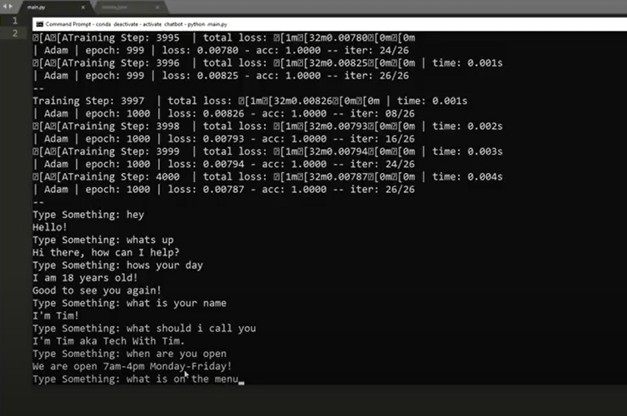
Chat Bot Example – Free Form Text

Slide 5
What you need to get started:
Python 3.6 or Higher (uninstall or reinstall if needed)
pip install nltk(natural language tool kit)
Note: To uninstall anything it is – pip uninstall name

Slide 6
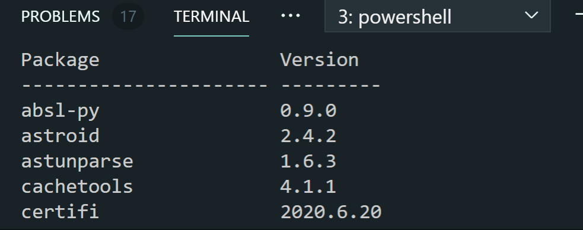
Verify what is installed
pip list

Slide 7
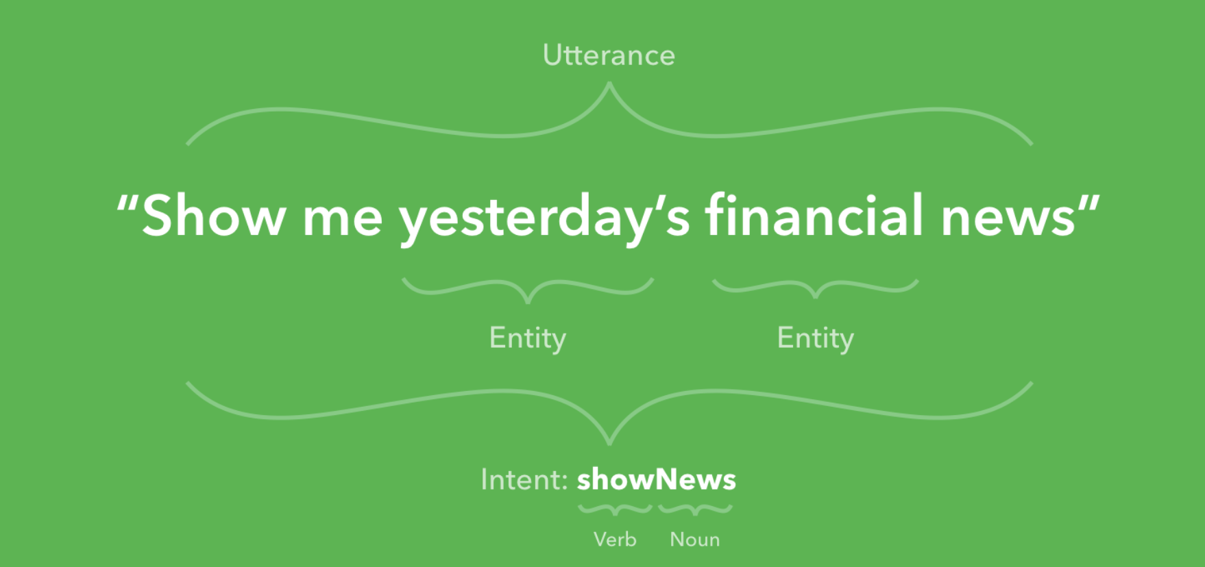
Overview:

Slide 8
Definitions:
Utterance: Anything the user says. For example, if a user types “show me yesterday’s financial news”, the entire sentence is the utterance.
Intent: An intent is the user’s intention. For example, if a user types “show me yesterday’s financial news”, the user’s intent is to retrieve a list of financial headlines. Intents are given a name, often a verb and a noun, such as “showNews”.
Entity: An entity modifies an intent. For example, if a user types “show me yesterday’s financial news”, the entities are “yesterday” and “financial”. Entities are given a name, such as “dateTime” and “newsType”. Entities are sometimes referred to as slots.

Slide 9
Other Terms:
Broadcast: A broadcast is a message sent proactively to users. It is not a response to user input. Also referred to as “subscription messaging”, a broadcast is the chatbot equivalent of a push message in a mobile app.
Channel: Channels are the medium for chatbot conversations. Examples of channels include Facebook Messenger, Skype, Slack and SMS. Email and web chat windows are also mediums.
Conversational UI: User interfaces based on human speech, either written or spoken. Conversational UIs don’t use buttons, links or other graphical elements. Many chatbots, including Tangowork, mix conversational UI with graphical UI.

Slide 10
Other Terms Continued:
Natural Language Processing (NLP): NLP examines an utterance and extracts the intent and entities. NLP software includes Amazon Lex, Facebook’s Wit.ai, and Microsoft’s LUIS.
Pilot: The stage of development where the chatbot is deployed to a small group of users for testing. Pilots are especially critical for chatbots, because unlike a web application, the range of possible user input is unlimited.
Proof-of-concept (POC): The stage of development where the chatbot functions properly so long as the input is artificially constrained. A POC demonstrates the potential. POCs are especially useful for emerging technologies that are not fully understood by stakeholders, like chatbots.
Response: Anything the bot says in response to user input.

Slide 11
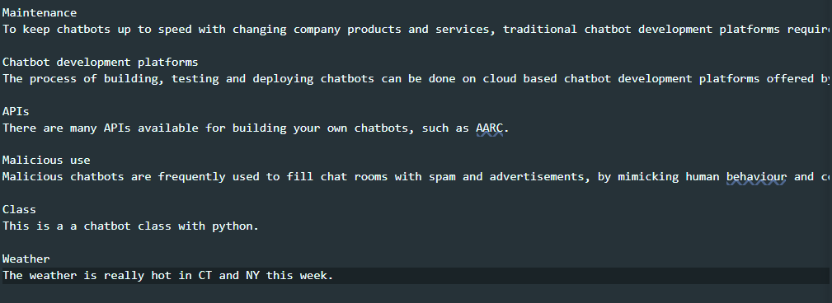
Example of Intent File:

Slide 12
Let’s start coding - Imports
#import necessary libraries
import io
import random
import string # to process standard python strings
import warnings
import numpy as np
from sklearn.feature_extraction.text import TfidfVectorizer
from sklearn.metrics.pairwise import cosine_similarity
import warnings
warnings.filterwarnings('ignore')

Slide 13
More Imports
import nltk
from nltk.stem import WordNetLemmatizer
nltk.download('popular', quiet=True) # for downloading packages

Slide 14
Read our intents
#Reading in the intents (note they are from a file you create called chatbot.txt
with open('chatbot.txt','r', encoding='utf8', errors ='ignore') as fin:
raw = fin.read().lower()

Slide 15
Convert your intents
#Tokenisation
sent_tokens = nltk.sent_tokenize(raw)# converts to list of sentences
word_tokens = nltk.word_tokenize(raw)# converts to list of words

Slide 16
Preprocessing
# Preprocessing
lemmer = WordNetLemmatizer()
def LemTokens(tokens):
return [lemmer.lemmatize(token) for token in tokens]
remove_punct_dict = dict((ord(punct), None) for punct in string.punctuation)
def LemNormalize(text):
return LemTokens(nltk.word_tokenize(text.lower().translate(remove_punct_dict)))

Slide 17
Keywords to match
# Keyword Matching
GREETING_INPUTS = ("hello", "hi", "greetings", "sup", "what's up","hey",)
GREETING_RESPONSES = ["hi", "hey", "*nods*", "hi there", "hello", "I am glad! You are talking to me"]

Slide 18
Let’s make a Greeting Function
def greeting(sentence):
"""If user's input is a greeting, return a greeting response""“
for word in sentence.split():
if word.lower() in GREETING_INPUTS:
return random.choice(GREETING_RESPONSES)

Slide 19
Let’s make a response function
# Generating response
def response(user_response):
robo_response=‘’ # response variable – initialize it
sent_tokens.append(user_response)
TfidfVec = TfidfVectorizer(tokenizer=LemNormalize, stop_words='english')
tfidf = TfidfVec.fit_transform(sent_tokens)
vals = cosine_similarity(tfidf[-1], tfidf)
idx=vals.argsort()[0][-2]
flat = vals.flatten()
flat.sort()
req_tfidf = flat[-2]
if(req_tfidf==0):
robo_response=robo_response+"I am sorry! I don't understand you"
return robo_response
else:
robo_response = robo_response+sent_tokens[idx]
return robo_response

Slide 20
Let’s use a loop to for a conversation
flag=True
print("ROBO: My name is Robo. I will answer your queries about Chatbots. If you want to exit, type Bye!")
while(flag==True):
user_response = input()
user_response=user_response.lower()
if(user_response!='bye'):
if(user_response=='thanks' or user_response=='thank you' ):
flag=False
print("ROBO: You are welcome..")
else:
if(greeting(user_response)!=None):
print("ROBO: "+greeting(user_response))
else:
print("ROBO: ",end="")
print(response(user_response))
sent_tokens.remove(user_response)
else:
flag=False
print("ROBO: Bye! take care..")

Slide 21
Homework:
Add to your intent file and test your results

